Slide 1
Spring AOP Advices
There are 4 types of advices supported in spring1.2 old style aop implementation. Though it is supported in spring 3, but it is recommended to use spring aop with aspectJ that we are going to learn later.
Before Advice is executed before the actual method call.
Before Advice
method
After Advice is executed after the actual method call. If method returns a value, it is executed after returning value.
method
After Advice

Slide 2
Spring AOP Advices
Around Advice is executed before and after the actual method call.
Around Advice
method
Around Advice
method
Throws Advice is executed if actual method throws an exception.
Throws Advice

Slide 3
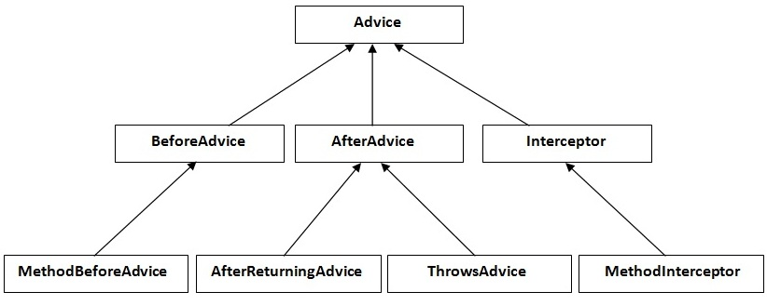
Spring AOP Advices
All are interfaces in aop.
MethodBeforeAdvice interface extends the BeforeAdvice interface.
AfterReturningAdvice interface extends the AfterAdvice interface.
ThrowsAdvice interface extends the AfterAdvice interface.
MethodInterceptor interface extends the Interceptor interface. It is used in around advice.
Advice hierarchy

